Slide 1
Identity & Access Management
A set of tools & services used to manage access to systems or resources. Focuses on Authentication and Authorization
Typical IT Architecture
I&AM Architecture
Multiple Identity Stores
Multiple Administration Points
Redundant data synchronization and replication
Users must authenticate to each application
Single Identity Store
Single Administration Point
Reduced replication and synchronization
Single Sign-In
Ability to present multiple data views
End devices: Devices that a person can use for communication purpose
Network devices: Equipment's that mediate and transfer data between end devices
Edge devices: Run applications locally and make immediate decisions. Data does not need to be sent over network connections. Enhances security by keeping sensitive data from being transported beyond the edge where it is needed.

Slide 2
Network devices
NIC
NIC is used to physically connect host devices to the network.
Each NIC is identified by a unique address called a Media Access Control (MAC)
Repeaters
Repeaters regenerate analog/digital signals that are distorted by transmission loss
Does not make an intelligent decision concerning forwarding packets
Hub
Hubs connect multiple devices in a network as one whole single unit
Active hubs can regenerate signals.
Does not make an intelligent decision concerning forwarding packets
Switch
Switches are better than hubs as they make intelligent decisions forwarding data to the intended destination thereby reducing traffic and congestion
Bridge
Bridges provide connections between LANs.
They also check data to determine if it should cross the bridge.
Makes intelligent decisions concerning forwarding packets
Notes:
Once again, I tried to pull graphics from the original network diagram. I had to alter the wireless router graphic in Photoshop to make it look better. I darken the and removed a white background to make it look consistent in relation to the standard router.

Slide 3
Router
Connects multiple servers together and determines best path for packets to reach destination
Routers can regenerate signals, concentrate multiple connections and manage data transfers.
Gateway
hardware used in telecommunications that allows data to flow from one discrete network to another.
Gateways are distinct from routers or switches in that they communicate using more than one protocol
Firewall
Firewalls are inserted in connections between secure internal networks and potentially insecure external networks such as the Internet.
Firewalls are typically configured to reject access requests from unrecognized sources while allowing actions from recognized ones.
Modem
MODulate the computer’s digital signal into analog signal and DEModulates the analog signal back into digital form at receiver’s end. Can be synchronous/asynchronous
Notes:
Once again, I tried to pull graphics from the original network diagram. I had to alter the wireless router graphic in Photoshop to make it look better. I darken the and removed a white background to make it look consistent in relation to the standard router.

Slide 4
TYPES OF SERVER
SERVER
It is a physical computer that provide services to all connected clients allowing them to access available information or resources.
Have higher storage capacity as multiple disks can be inserted into them
Web Servers - respond to requests from clients such as web browsers.
Application Server - provides services to applications such as a mobile app.
Chat Servers - enable large numbers users to exchange information near instantaneously.
FTP Server - move files securely between computers
Name Server - Servers that look up addresses such as mapping domain to an IP
Database Server - provides database services to computers.
Game Server - The server transmits enough data about its internal state to allow its connected clients to maintain their own accurate version of the game world for display to players.
Media Server - Delivers media such as streaming video or audio.
Proxy Server - Acts as an intermediary between clients and servers to implement functions such as security, monitoring or anonymization.

Slide 5
Asset Inventory Tool
Identify Assets
On-access or real-time detection:
detection of traffic generated by the endpoint.
Advantage: detection is immediate.
Disadvantage: there must be a sensor located near this traffic; not practical
On-demand or Scheduled Detection :
The system queries network addresses for a response according to a schedule.
Advantage: Sensors can execute scans from a limited number of locations
Disadvantage: Detection is not immediate and limited to a schedule
Active tools: scan through network address ranges
Passive tools: identify hosts based on analyzing their traffic
Traffic-filtering technologies are commonly divided into
Stateless firewall/ Packet filtering
Stateful firewall technologies.

Slide 6
Stateless Firewalls
A stateless firewall doesn’t maintain any remembered context (or “state”) with respect to the packets it is processing. Instead, it treats each packet attempting to travel through it in isolation without considering packets that it has processed previously.
Stateless firewalls may have to be fairly restrictive in order to prevent most attacks
Statefull Firewalls
Stateful firewalls maintain tables containing information on each active connection, including the IP addresses, ports, and sequence numbers of packets.
Using these tables, stateful firewalls can allow only inbound TCP packets that are in response to a connection initiated from within the internal network.
Allow only requested TCP connections

Slide 7
Solutions combining traffic filtering with other Technologies
Virtual private networking (VPN) - Technology that allows private networks to be safely extended over long distances by making use of a public network, such as the Internet. VPN guarantees data confidentiality, integrity, and authentication, despite the use of an untrusted network for transmission.
Remote access VPNs allow authorized clients to access a private network (intranet). Computer has internal IP when connected.
Site-to-site VPN solutions are designed to provide a secure bridge between two or more physically distant networks. Expensive leased lines to directly connect their intranets with cabling.
Intrusion Detection Systems - The identification and mitigation of actions aimed at compromising the security of the target (confidentiality, integrity, availability). Types of IDS:-
Rule-Based Intrusion Detection- identify the types of actions that match certain known profiles for an intrusion attack. Problem: Cannot deal with unknown attacks
Statistical Intrusion Detection- Alarm when a user or host deviates significantly from the stored profile of the typical ways that a user acts or a host is used. Problem: High false positive rate, cannot tell which attack triggers the alarm

Slide 8
SERVER STORAGE
DAS (Direct Attached Storage) is a disk which is physically attached to the host machine.
Advantages of DAS:
Simpler to setup, cheaper, faster, better latency
Networks not necessary, doesn’t use IP addresses
Disadvantages of DAS:
Dedicated resource to a single computer
Requires a special hardware connection
Can’t manage DAS via a network
NAS (Network Attached Storage) is a filesystem delivered over the network. It is ready to mount and use.
Advantages of NAS:
provide large storage to many users
easier to setup and configure
Allows users permissions, folder privileges,
Higher utilization of storage resources
Disadvantages of NAS:
Requires IP Address(es) and takes up network space
Performance can be affected by network status
Slow latency

Slide 9
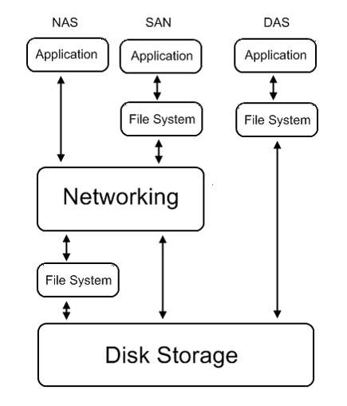
SERVER STORAGE
SAN ( Storage Attached Network) device/disk which is delivered over the network.
Advantages of SAN:
High speed like DAS
Higher hardware utilization like NAS
Allows virtual environments, cloud computing
Disadvantages of SAN:
Performance limited by network
Requires multiple static IP Addresses
Complex networking planning
More expensive

Slide 10
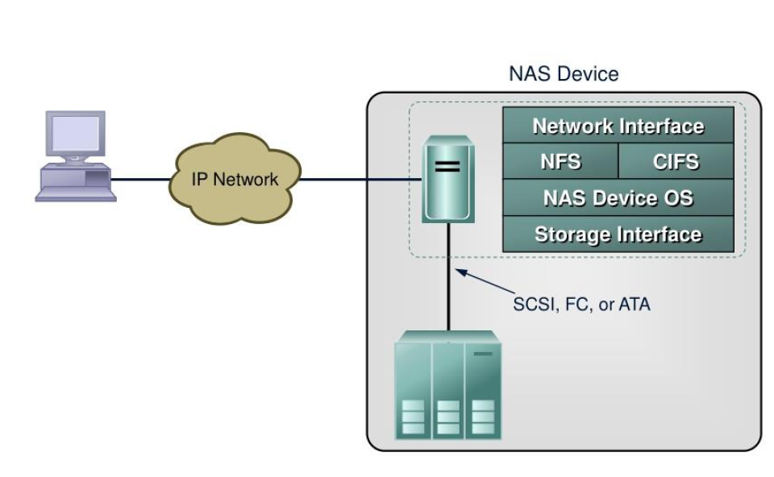
Network Attached Storage (NAS) & and File services protocols
Centralizes storage
Supports global information access
Improves efficiency & flexibility
Simplifies management
Scalability and High availability
Storage
Network File System (NFS)
Client/server application
Uses RPC mechanisms over TCP protocol
hierarchical file structures for local file system structures
Access to the mount can be controlled by permissions
Common Internet File System (CIFS)
Client applications access files on a computer running server applications that accept the SMB protocol
Better control of files than FTP
Potentially better access than Web browsers and HTTP

Slide 11
Content Management System
A content management system is a computer application that allows publishing, modifying, organizing, deleting and maintaining content. CMSs are often used to run websites, indexing, search, and retrieval. It has two elements:
Content management application (CMA) is the front-end user interface that allows a user to add, modify and delete content from a website
Content delivery application (CDA) compiles that information and updates the Web site.
Web CMS
Designed to allow users with little knowledge of web programming to create and manage website content
Uses a database to store page content, metadata, and other information assets.
Advantages
Low cost, Easy to use
Easy customization
Automated templates
Scalable feature sets
Web standards upgrades
Collaboration
Workflow management
Disadvantages
Cost of implementations
Cost of maintenance
Latency issues
Security

Slide 12
Popular CMS
WordPress popular CMS
Textpattern open source CMS.
ExpressionEngine commercial CMS
MediaWiki powers Wikipedia
eXo Platform Open Source Social CMS.
Why are CMS platforms so vulnerable?
They are built on open source frameworks.
Website operators use weak passwords vulnerable to brute force attacks, inject the website with malware
Protection from CMS vulnerabilities
Create a regular schedule to update
Regularly backup
Use a strong authentication, or two-factor authentication

Slide 13
Unrestricted Access
Impacted employee productivity - prevent excessive non-productive web surfing and preserves network bandwidth.
Hacker Attacks and Privacy Violations - Instant messaging, peer-to-peer file sharing and multimedia downloads make businesses vulnerable to backdoor attacks.
Secure Content Management Solutions
site blocking approach
uses list-based or URL-based filters to identify and block certain web sites.
Some solutions rely on white lists that allow access to only those sites that appear on the list. Other solutions use black lists, which permit access to all sites except those on the black list.
keyword-blocking
Instead of blocking URL’s, it compares the keyboard data to a user-defined library of words and phrases. When a match to one of the blocked words or phrases is detected, the solution filters or blocks the data
The problem with this approach is that it can inadvertently block legitimate pages based on the fact that they contain one or more targeted keywords.

Slide 14
Solution Architectures
Client Solutions
include a management interface and a database of blocked web sites. Eg; net nanny
Standalone Solutions
consist of a dedicated database server for defining policies and a separate firewall/gateway that enforces these policies.
These solutions are more manageable than client based solutions because an administrator can create a policy once on the gateway and then apply it across all.
However, they are expensive and require additional storage. Eg: Surf Control.
Integrated Solutions
Integrate management and processing in a single gateway/firewall, thereby reducing expenses. However performance can suffer due to multi-tasking. Eg: Watch Guard.

